Slide 1

Team 10:
Sai Krishna - 016033758
Akshay - 015924922
Aravind - 107115098
Santhosh - 016002454
Varun - 016029975
Harshini- 016005912
Abhiram - 015962128

Slide 2
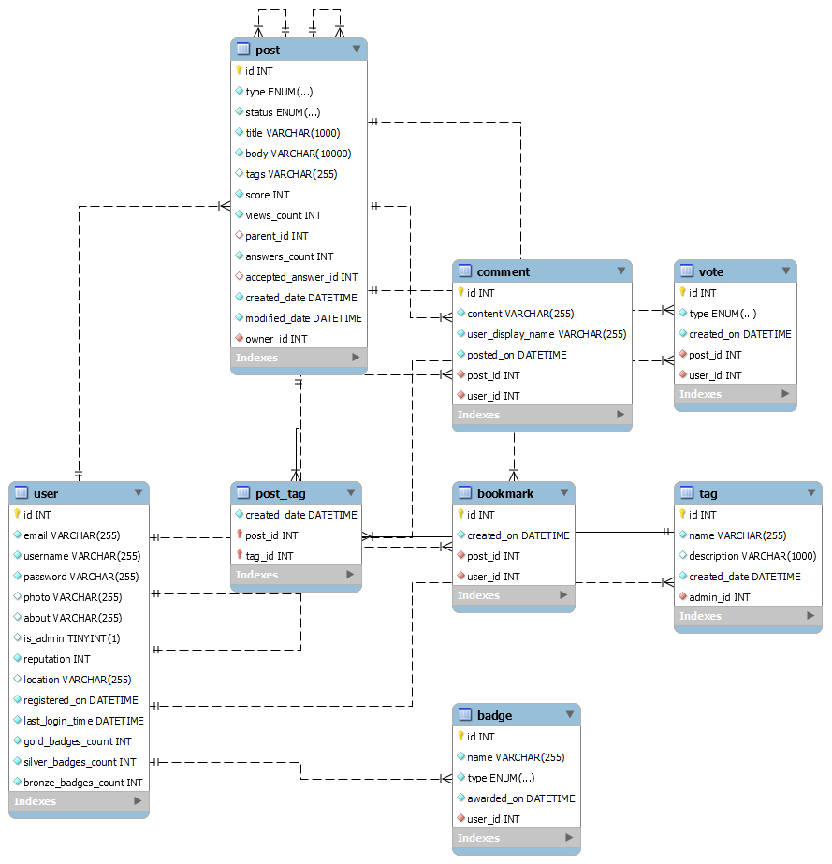
Database Schema for MySQL Tables

Slide 3
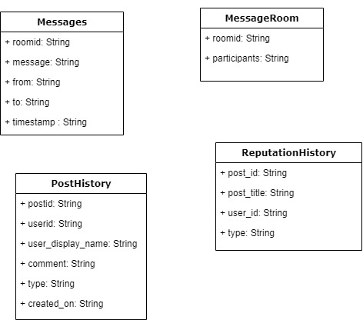
Database Schema for MongoDB Tables (Cont)

Slide 4
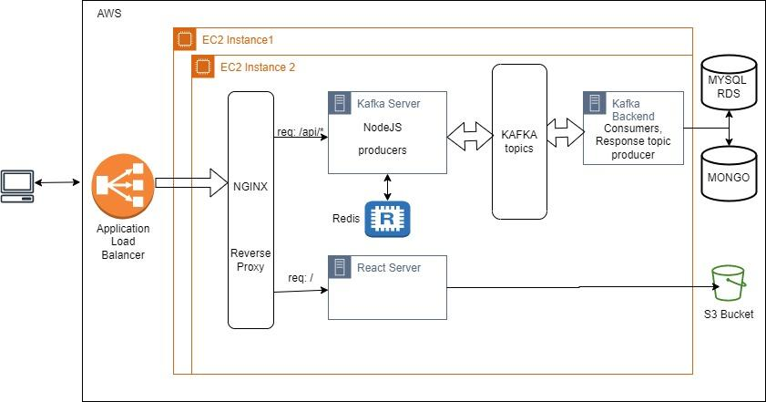
System Architecture Design

Slide 5
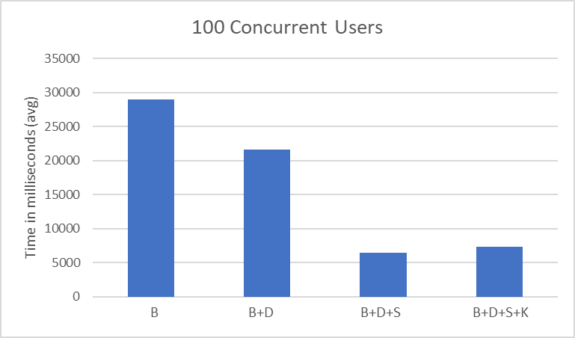
Performance Analysis for 100 concurrent users

Slide 6
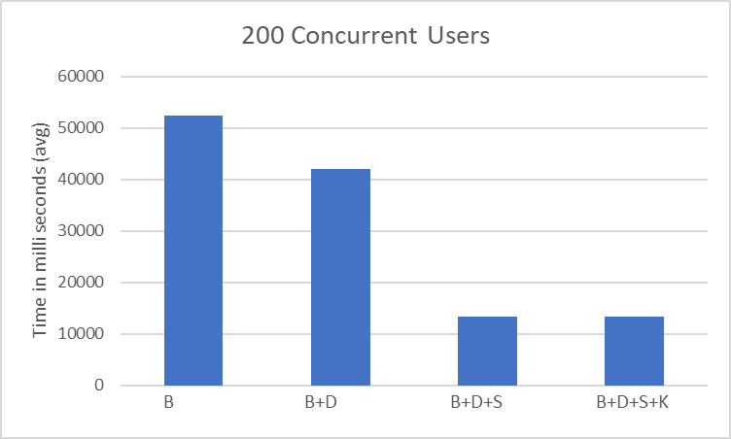
Performance Analysis for 200 concurrent users

Slide 7
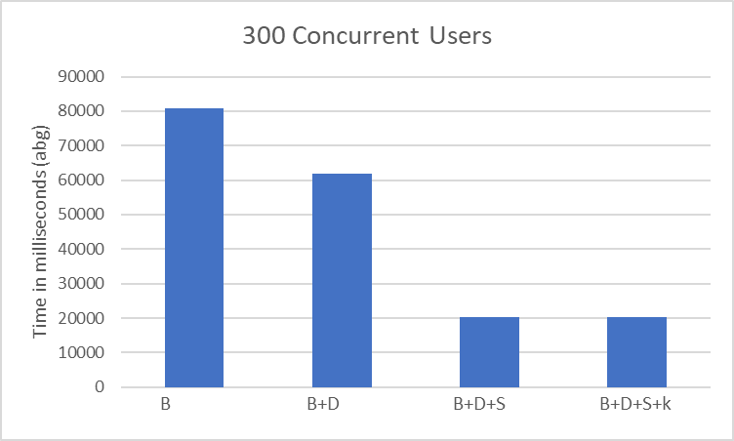
Performance Analysis for 300 concurrent users

Slide 8
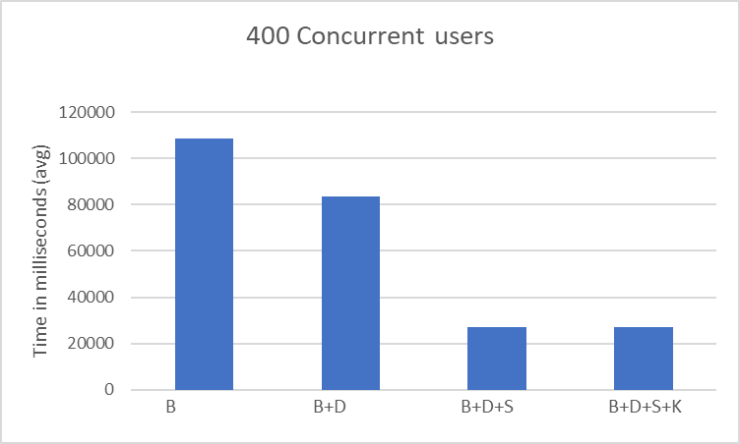
Performance Analysis for 400 concurrent users

Slide 9
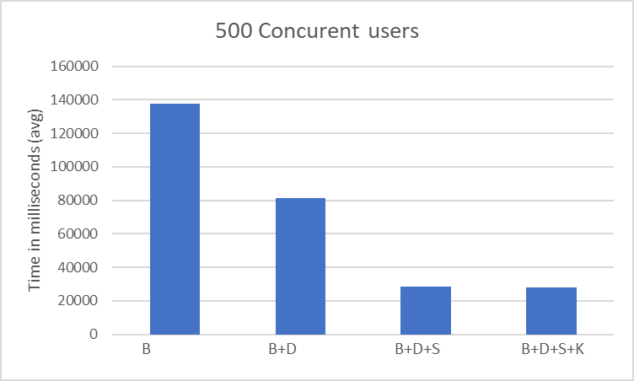
Performance Analysis for 500 concurrent users

Slide 10
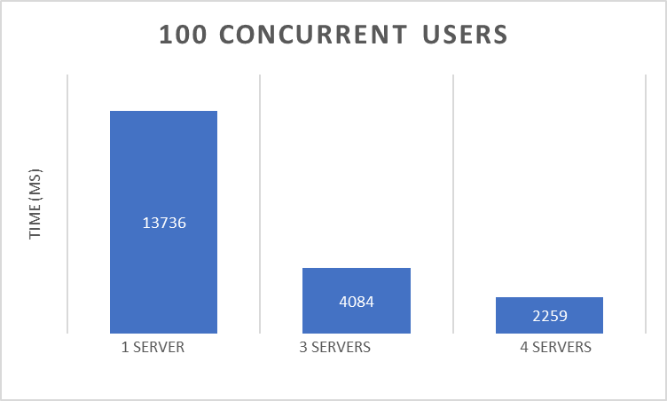
Performance comparison of services with different deployment configurations with Load Balancers

Slide 11
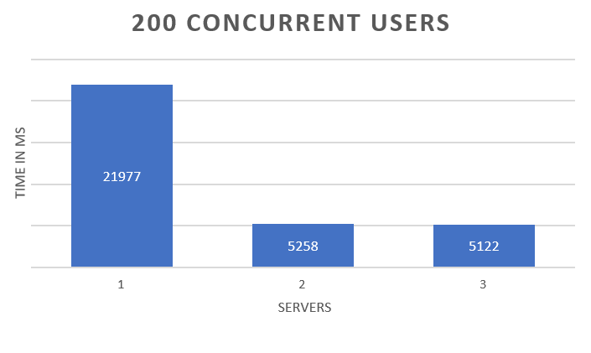
Performance comparison of services with different deployment configurations with Load Balancers

Slide 12
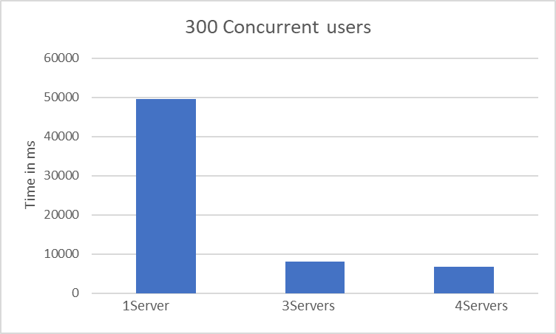
Performance comparison of services with different deployment configurations with Load Balancers

Slide 13
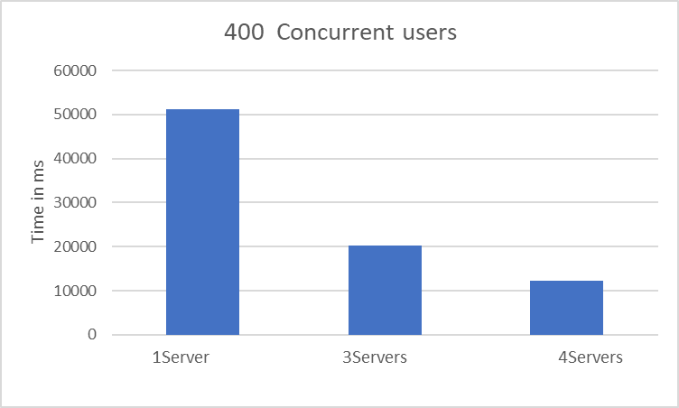
Performance comparison of services with different deployment configurations with Load Balancers

Slide 14
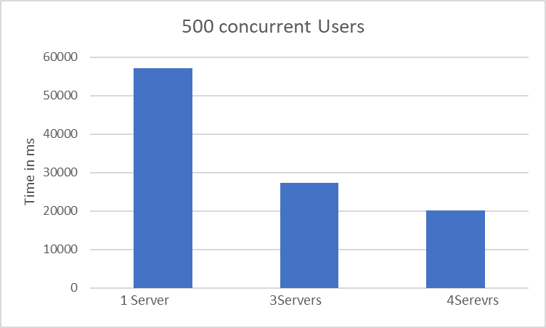
Performance comparison of services with different deployment configurations with Load Balancers

Slide 15







Our Team
Sai Krishna Kaaja
Akshay Madiwalar
Aravind Thonupunuri
Santhosh Bodla
Varun Reddy Yedulla
Harshini Kosuri
Abhiram Yenugadhati

Slide 16
THANK YOU!

